Slide 1
Session Two
Compliance
CHCLEG003 Manage Legal and Ethical Compliance
CHC52015: Diploma of Community Services
© Chisholm Institute 2018
Images sourced from Shutterstock under licence
Session 2 of 10

Slide 2
Review
One thing you learned last week?
Did you read and review your assessment guide?
Do you have any questions about what we covered last week?

Slide 3
Legal compliance
What is legal compliance?
Think of your workplace, education, shopping centres and other places and think of the following and discuss why they are in place
Health and Safety
Assignment policy
“slippery when wet” signs
“watch your step” signs
Warnings and labels on food items
“may contain nuts” signs
Think of other examples

Slide 4
Breaches
What is a breach?
It stems from duty of care and there are three elements
Duty of care exists
Duty of care is breached
The harm and injury has occurred
Keep in mind that the harm and injury can be physical, mental, financial etc
What happens after the breach of compliance occurs?
Discuss

Slide 5
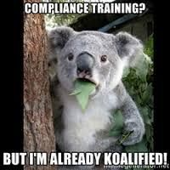
What do you think are compliance requirements?
How can we stay compliant?
Where can we go for more information?
Discuss

Slide 6
Compliance Requirements
It is essential to be aware of the various compliance requirements that apply to your organisation
Identification of these compliance requirements will enable you to develop compliance plans and ensure that you don’t breach any rules or regulations
There are numerous sources of information which relates to specific service areas in different professions in Australia
Your organisation may consider hiring a specialist on compliance who will work closely with the organisation

Slide 7
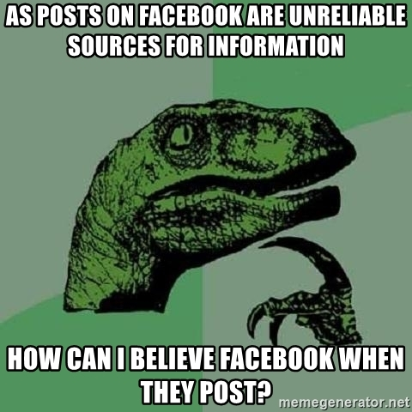
Sources of information
Who is responsible for compliance?
Where does the information come from?
What are the sources of information?
Is there a regulatory authority? If yes, who?
Who governs this area of law?
Discuss

Slide 8
Sources of information on compliance
Some examples of sources of information on compliance requirements are:
Correspondence such as emails and other written information which is provided by internal and external resources
Information received through third parties such as relevant websites
Information received through networks such as newsletters, bulletins
Information received through regulatory authorities, legislation etc

Slide 9

Always seek specialist advice when not sure
Ask a supervisor
Ask a colleague
Ask your professional body

Slide 10
Regulatory Authority
These are public bodies that take the governing responsibility
These bodies are created by statute
Their primary task is protecting the public
Regulatory authorities are the most reliable sources of information
They can also be the specialist service where advice can be sought
They are also responsible for policy writing and governing this area of law
Can you think of any regulatory body in your area of work?

Slide 11
… Example
An example of a regulatory authority in Australia would be the Department of Health, which seeks to improve and maintain the high standards of Australian health care by ‘strengthening evidence-based policy advice’ and ‘improving program management, research, regulation and partnerships with other government agencies, consumers and stakeholders.’

Slide 12
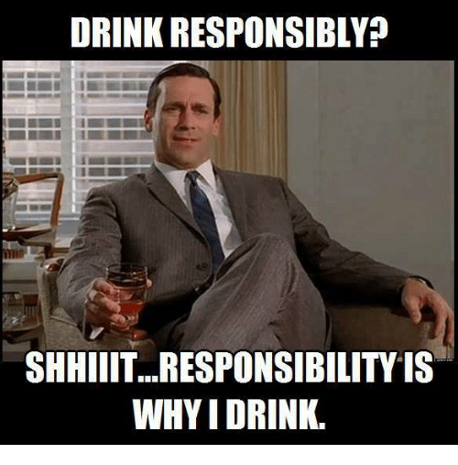

Slide 13
Responsibilities of regulatory authorities
Laying out compliance requirements for the relevant field, sector and profession
Setting out conditions, restrictions and rules
Setting standards
Exercising their authority when needed
Making important decisions
Enforcing the decisions
Lobbying, advocacy, education and policy making
Disciplinary action in case of any breaches

Slide 14

… Think…
What can you do to stay compliant?
Why should you stay compliant?
Is it your responsibility?
Will it impact you? If yes, how? If no, why?
What goes hand in hand with compliance?

Slide 15


Slide 16
… Next session
Determining ethical responsibilities
Ethical Frameworks
Privacy legislation
International expectations
Australian ethical standards
Scope of practice considerations

Slide 17
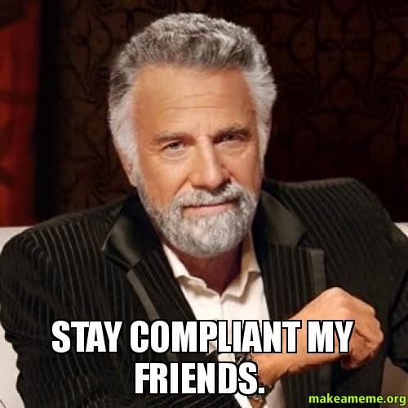
See you next time …

